Slide 1
Tests block BGO
Data analysis

Slide 2

1. Raw data analysis
Data file contains the entries of each read-out channel (8 channels on PXI)
The first 4 correspond to the amplified signals of the 4 PMs of the block, the fifth to the amplified sum, the others are empty (baseline only)
The data are just read with no selection and the sum is recalculated with the 4 PMs signals (it could differ from the one collected by the PXI)
The following plot are produced:
Signal amplitude spectrum of the 4 PMs – log scale
Flood map (no correction or selection)
1D integrated X and Y position profiles
Energy spectrum (amplitude spectrum of the sum)
A ROOT output file stores these plots and is saved in the RUN folder with the name
output_RUNXXXXX.root
Macro file
analyse_BGO.C
Executed as
analyse_BGO(Nrun)
where Nrun is the run number with only the significant digits (EX: 16 is enough, not necessary 00016)

Slide 3
1. Raw data analysis: results
Block 3166 (original)
Card 167
HV = 1250, THR = 100 mV, Amplification factor = 20
²²Na source – homogeneous irradiation
a.
PM amplitude spectrum
Flood map
Energy spectrum
1D position profiles
b.
c.
d.

Slide 4
2. PM gain calibration
The PM amplitude distributions allow to identify the peak at low ADC channels and the one at high ADC values.
The initial peak must be shifted to 0 for all the PMs –> OFFSET tuning
The second peak corresponds to high energy events (1275 keV for ²²Na), and so the 4 PMs response must be equalized and the peak located at 1275 keV -> GAIN calibration
A text file must be produced, in the form
PM_0 PM_1 PM_2 PM_3 -> top line can be everything
2399. 1445. 1241. 1609. -> peak positions for the 4 PMs, separated by tabs
This file is passed as argument to the calibration macro, which also rejects saturated events or event below threshold (everything can be set in the code)
The following plot are produced
Calibrated signal amplitude spectrum of the 4 PMs + sum – log scale
Flood map (with calibration and selection)
Calibrated 1D integrated X and Y position profiles
Calibrated energy spectrum (amplitude spectrum of the sum)
An output ROOT file is produced in the RUN folder to store these plots
outputCalibration_RUNXXXXX.root
Macro file
calibration_BGO.C
Executed as
calibration_BGO(Nrun, conf_file_name)
where Nrun is the run number as before and conf_file_name is the configuration file with its path (even relative)

Slide 5
2. PM gain calibration: results
Block 3166 (original)
Card 167
HV = 1250, THR = 100 mV, Amplification factor = 20
²²Na source – homogeneous irradiation
a.
PM amplitude spectrum
Flood map
Energy spectrum
1D position profiles
b.
c.
d.

Slide 6
3. Pixel identification
After the gain and offset calibration, a second calibration step is needed for the energy response optimization, on a single pixel basis
The pixel positions must be identified in order to assign each event to a single pixel, and then analyse the energy spectrum of each pixel and equalize their response
The pixel identification process is performed by an automatic algorithm
It opens the calibrated output root file
It retrieves the calibrated flood map
It re-creates the 1D integrated profiles and identifies the peaks
With the identified peaks it calculates the valleys positions and divides the map in N rows and M columns
It traces the 1D position profile of each row and columns and searches the peaks on each distribution
It finally finds the pixel positions with this two data sets
Moreover, the algorithm is able to identify the missing pixels and show
their positions
The following plots are produced:
1D integrated position profiles (with and without peaks)
Flood map with highlighted rows and columns
1D position profile for each row and column with the identified peaks
Flood map with the calculated pixel positions
An output text file is produced in the RUN folder with the position of each identified pixel, in the form
PIXEL L PIXEL C X Y
0 0
0 1 -0.775 -0.915 .....
With pixel row and column index and X and Y position
A root output file is also produced in the RUN folder to store all the plots -> outputPixels_RUNXXXXX.root
Macro file
pixel_id.C
with methods in
function.hh
Executed as
pixel_id(Nrun)
where Nrun is the run number as before

Slide 7
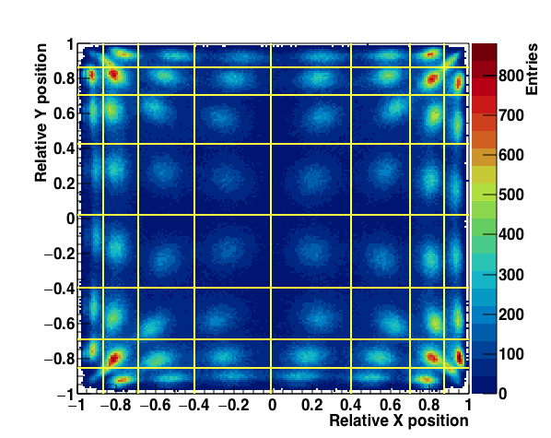
3.1 Pixel identification: results (i)
Block 3166 (original) - Card 167
HV = 1250, THR = 100 mV, AF = 20
²²Na source
Search for peaks on the 1D integrated distributions and definition of bands (rows and columns) to segment the map
The valley positions are calculated as the average value of two neighbor peaks
From this sections, the 1D distributions of each row and columns are produced and analysed to identify the peaks (see next slide)

Slide 8
3.1 Pixel identification: results (ii)
Block 3166 (original) - Card 167
HV = 1250, THR = 100 mV, AF = 20
²²Na source
COLUMNS

Slide 9
3.1 Pixel identification: results (iii)
Block 3166 (original) - Card 167
HV = 1250, THR = 100 mV, AF = 20
²²Na source
ROWS

Slide 10
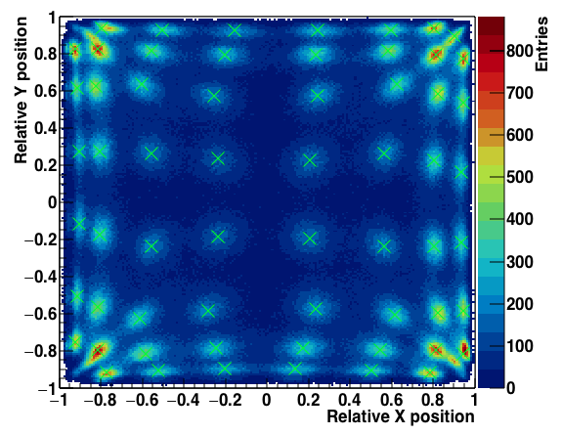
3.1 Pixel identification: results (iv)
Block 3166 (original) - Card 167
HV = 1250, THR = 100 mV, AF = 20
²²Na source
In the 3 highlighted distributions, some missing pixels are found
The algorithm will be able to detect them and identify their positions
The found peaks in the N rows and M columns are then analysed to identify the pixels, according to the band limits defined at the first step.
The pixels positions are stored in the text file
The missing pixels are highlighted
3 pixels cannot be found automatically. Look at the map to identify their position!
Pixel 0 0 0
Pixel 1 7 0
Pixel 2 0 7
Check the plot for the positions of the other pixels!
All position saved in ../data/RUN00007/pixels_RUN00007.txt

Slide 11
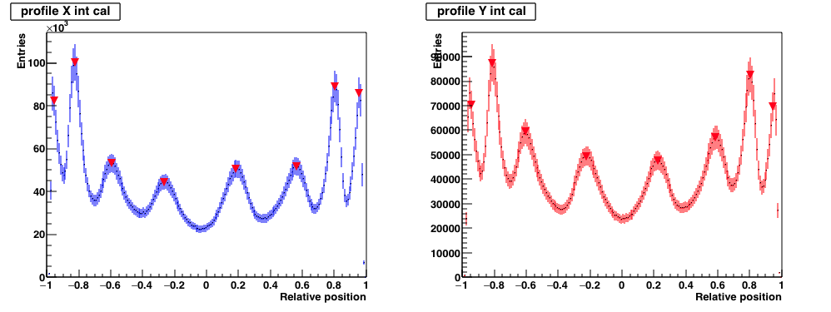
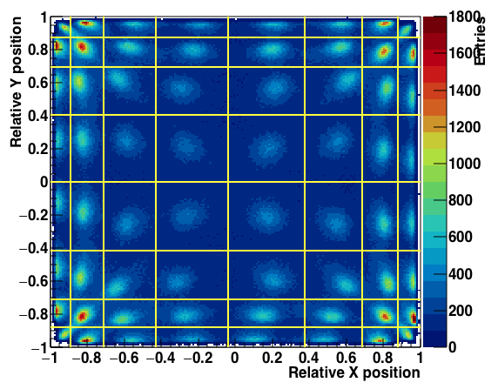
3.2 Pixel identification: results (i)
Block 3166 (original) - Card 167
HV = 1250, THR = 100 mV, AF = 20
⁶⁰Co source

Slide 12
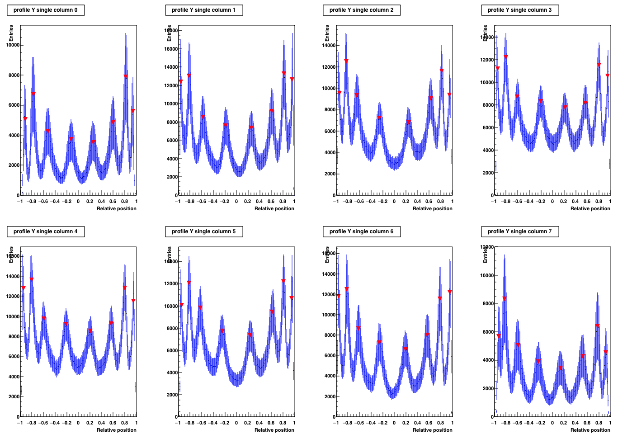
3.2 Pixel identification: results (ii)
Block 3166 (original) - Card 167
HV = 1250, THR = 100 mV, AF = 20
⁶⁰Co source
COLUMNS

Slide 13
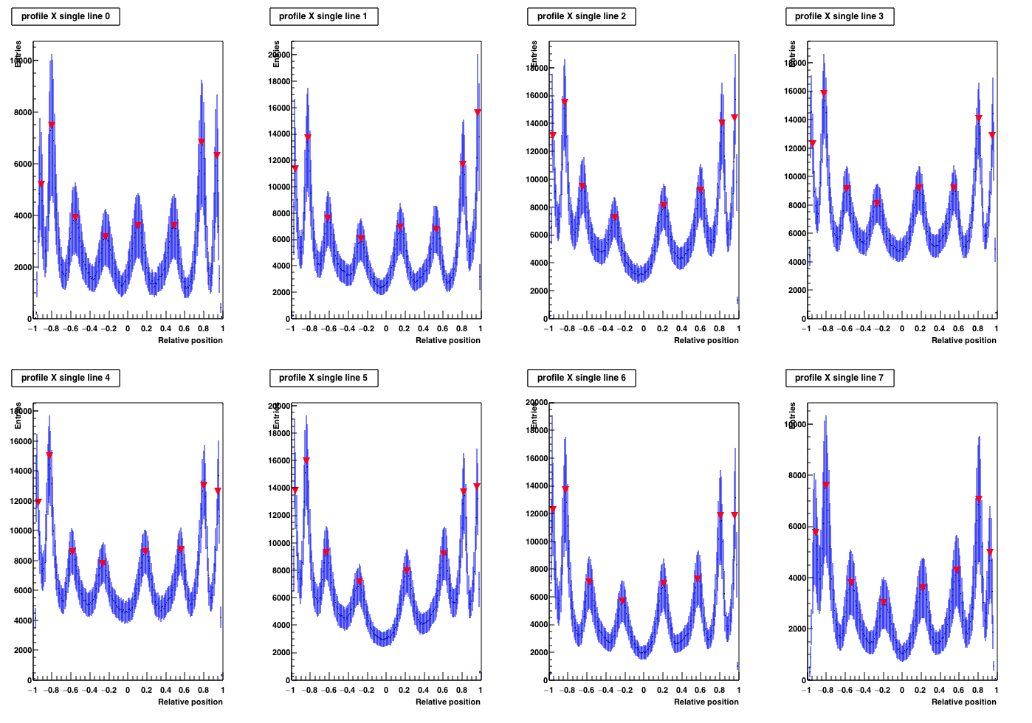
3.2 Pixel identification: results (iii)
Block 3166 (original) - Card 167
HV = 1250, THR = 100 mV, AF = 20
⁶⁰Co source
ROWS

Slide 14
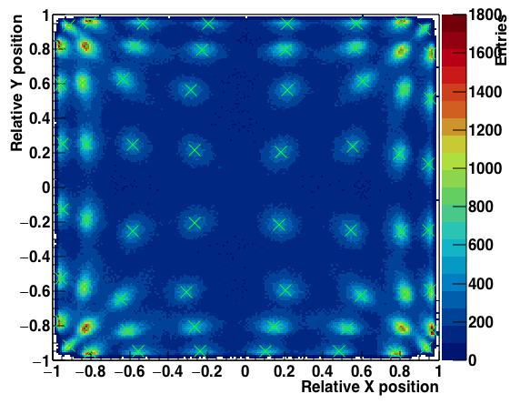
3.2 Pixel identification: results (iv)
Block 3166 (original) - Card 167
HV = 1250, THR = 100 mV, AF = 20
⁶⁰Co source
PIXEL L PIXEL C X Y
0 0 -0.915 -0.915
0 1 -0.805 -0.955
0 2 -0.555 -0.945
0 3 -0.235 -0.945
0 4 0.105 -0.945
0 5 0.485 -0.945 .....
.......
4 0.215 0.945
7 5 0.575 0.945
7 6 0.805 0.955
7 7 0.925 0.915

Slide 15
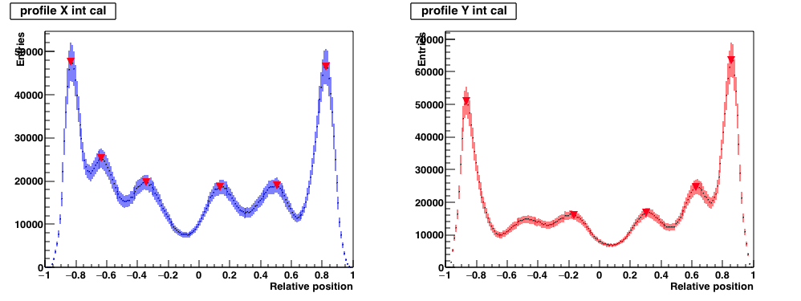
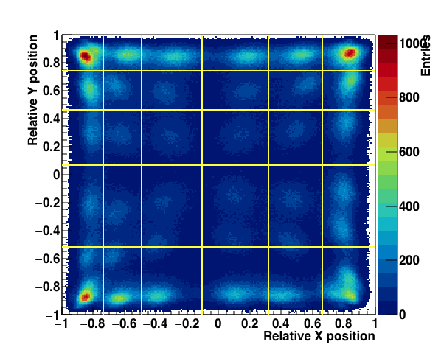
3.3 Pixel identification: results (i)
Block 0182 (reconditioned) - Card 88
HV = 1250, THR = 100 mV, AF = 50
²²Na source
6 columns
5 rows

Slide 16
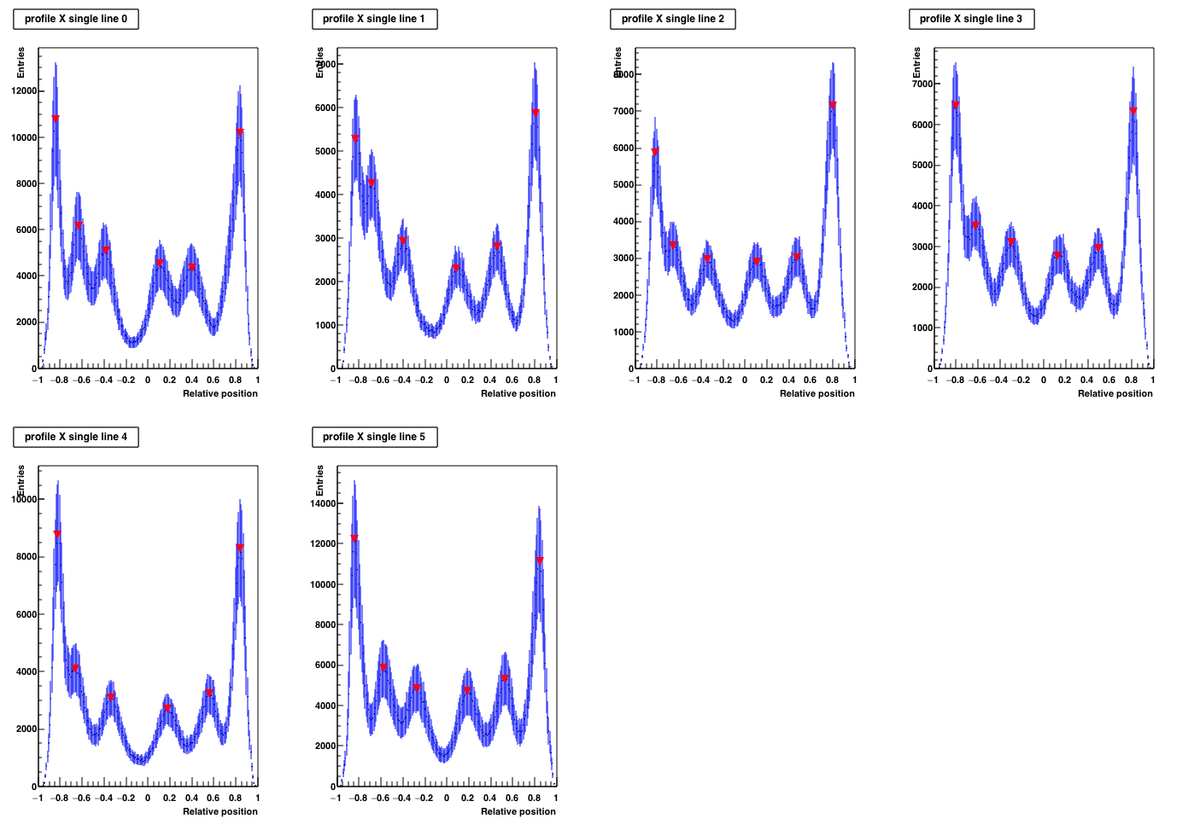
3.3 Pixel identification: results (ii)
Block 0182 (reconditioned) - Card 88
HV = 1250, THR = 100 mV, AF = 50
²²Na source
ROWS

Slide 17
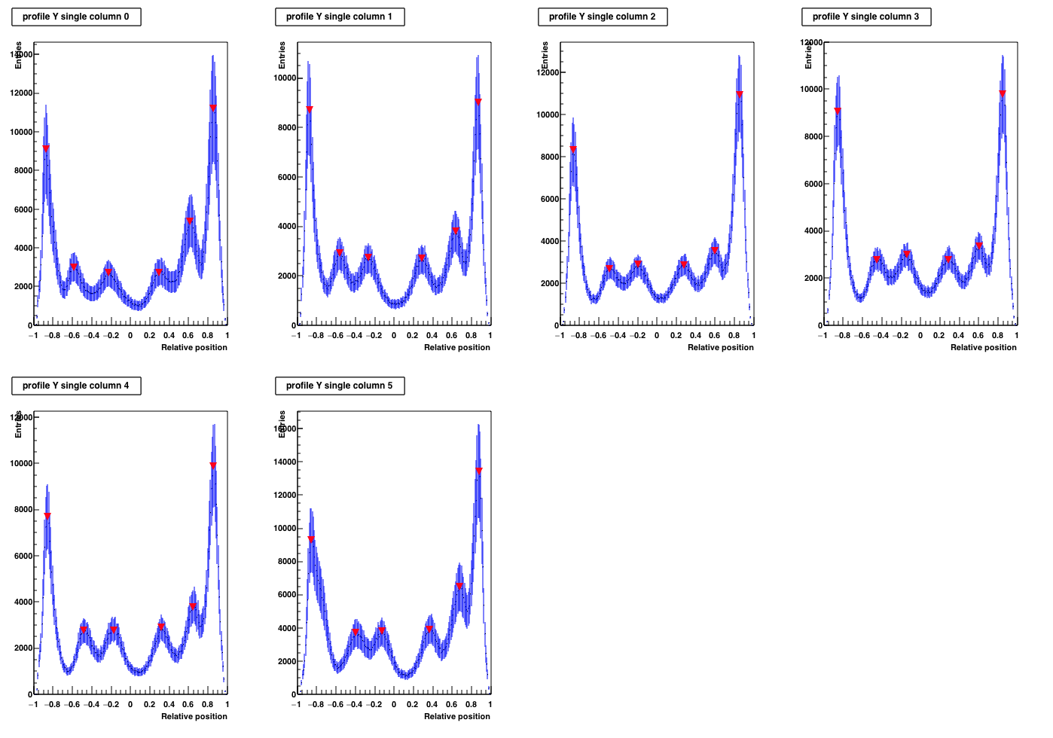
3.3 Pixel identification: results (iii)
Block 0182 (reconditioned) - Card 88
HV = 1250, THR = 100 mV, AF = 50
²²Na source
COLUMNS
Even if only 5 rows have had been identified during the first step, with the single column profiles 6 rows emerge in each column
The initial result must then be corrected!
The row and column limits are redefined and the map with the new limits is drawn

Slide 18
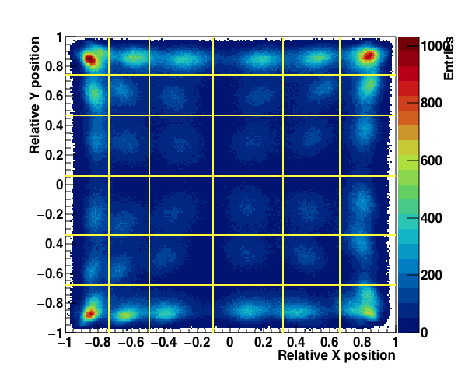
3.3 Pixel identification: results (iv)
Block 0182 (reconditioned) - Card 88
HV = 1250, THR = 100 mV, AF = 50
²²Na source
The new map and the new set limits reflect the observations of single rows and columns
Anyway, only a 6x6 matrix of pixels is expected

Slide 19
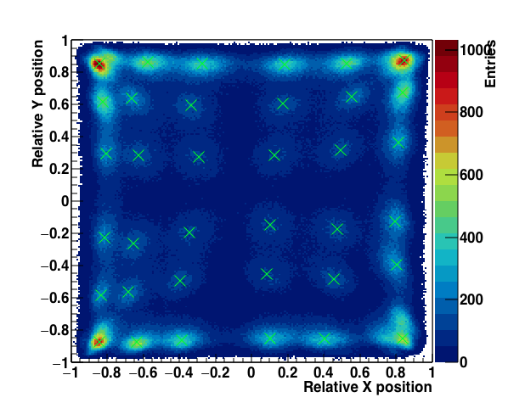

3.3 Pixel identification: results (v)
Block 0182 (reconditioned) - Card 88
HV = 1250, THR = 100 mV, AF = 50
²²Na source
PIXEL L PIXEL C X Y
0 0 -0.845 -0.875
0 1 -0.635 -0.875
0 2 -0.385 -0.865
0 3 0.105 -0.855
0 4 0.405 -0.855 .....
If the obtained matrix is not 8x8, there’s no way to understand which rows or columns are missing…. We can in principle suppose that they are the side rows and columns, but this is not always determined
So, the algorithm is not able to associate the pixel position to right index... The output file must be checked, knowing that the order of filling is by lines, as
end
start

Slide 20
4. Pixel energy calibration
At the end of the pixel identification process, you know the position of each pixel, with X and Y coordinates. The next stage involves the assignation of each event to a single pixel, and it is performed via the calculation of two outer products per events, once the event position is reconstructed.
The even data assignment is done by calculating the minimal distance between a column and a row average point (average position between two pseudo-pixels) with respect to the reconstructed event and then calculating two outer products, between the vector connecting the reconstructed point and closest column (row) average point and the vector connecting this
average point to the previous or next one on the same column (row). The sign of the products defines the column (row) where to assign the interaction. Knowing the relative position of
the interaction point with respect to the two minimal distance points on row and column, the correct pseudo-pixel is identified.
All is included in pixel_Ecal.C, with the functions in functions.h

Slide 21
4. Pixel energy calibration (ii)
Once each event is assigned to its pseudo-pixel, the energy spectrum can be obtained for each pseudo-pixel, and the response can be equalized.

